Slide 1
Packaging and Deploying SharePoint Framework Solutions
Notes:
This module examines the process of application lifecycle management (ALM) with SharePoint Framework solutions. The module explains the role of the App Catalog and walks through how to create a new App Catalog site for a SharePoint Online tenant. Students will learn how to bundle and package a SPFX solution for distribution and to optimize SPFX builds for a production environment. The module explains how to package third-party JavaScript libraries as external references and how to deploy SharePoint Framework solution resources to the Office 365 CDN. Students will also learn how to publish SharePoint Framework solution packages in the App Catalog as well as how to install a SPFX solution in a SharePoint site. The module also explains the process of upgrading an SPFX solution after it’s has already been deployed to a production environment.

Slide 2
Agenda
Creating the App Catalog Site in SharePoint Online
Packaging SPFX Solutions for Production
Packaging JavaScript Libraries as External References
Customizing SPFX Builds with Gulp and Webpack
Publishing and Updating SPFX Solutions
Installing an SPFX Solution in a SharePoint Site

Slide 3
Understanding the App Catalog
App publishing scheme based on App Catalog
App Catalog is site collection with special doc library
App packages are published (uploaded) to app catalog
Provides better app discovery, installation and upgrade
App Catalog in on-premises farms
One App Catalog site required for each web application
End users often play role of App Catalog administrator
App Catalog in Office 365 & SharePoint Online
One App Catalog site used to manage entire tenancy
Notes:
Apps can be deployed to a marketplace, either a public “SharePoint Marketplace” where other people can purchase and install your app, just like other marketplaces for smart phones, or using the App Catalog which acts like a private tenant-specific marketplace where apps aren’t bought and sold, rather they are just deployed by corporate developers or when administrators buy licenses and deploy the purchased app to the catalog.

Slide 4
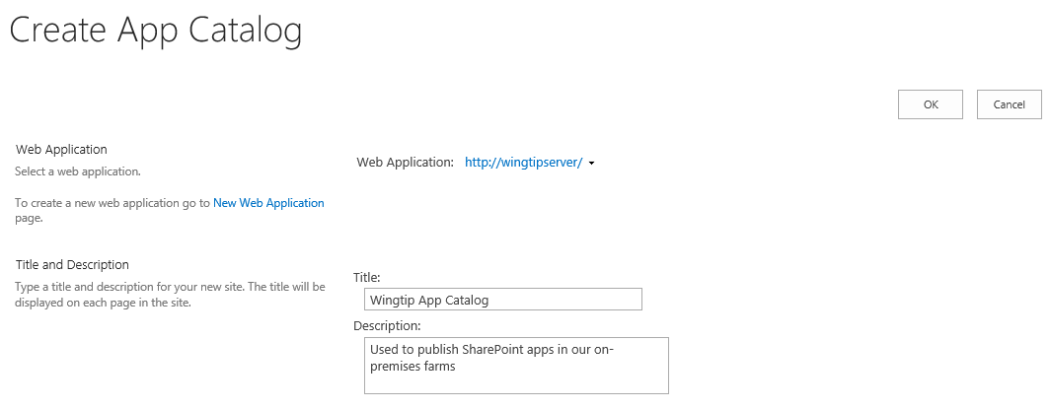
Creating the App Catalog Site Collection
You must create the App Catalog site collection
You can create it using a PowerShell script
You can create it using Central Administration
App Catalog site associated with one web application

Slide 5
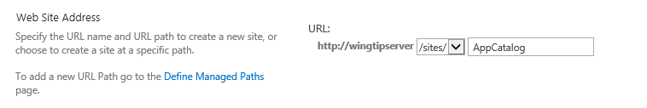
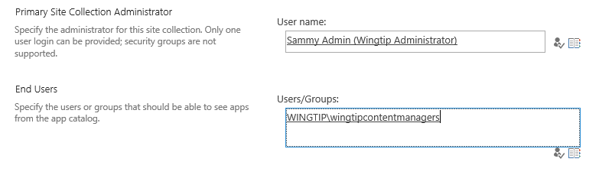
App Catalog URL and Permissions
App catalog site created at a specific URL
Creating App Catalog site with PowerShell is more flexible you can create site as top-level domain using host-named site collections (HNSCs)
Setting App Catalog permissions
Site collection administrator becomes App Catalog administrator
End user permissions allows user to discover and install apps

Slide 6
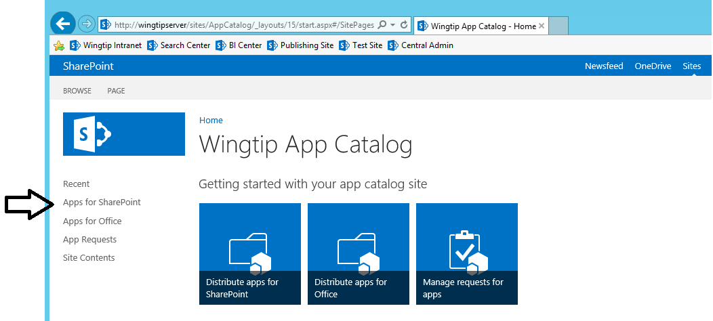
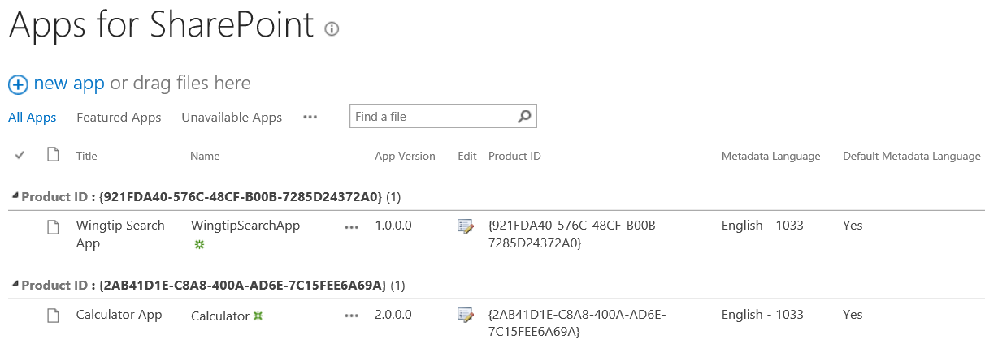
Apps for SharePoint Document Library
Apps for SharePoint is special document library
It's the place where you publish SharePoint apps
You upload app package and enter the related metadata

Slide 7
Creating an App Catalog Site

Slide 8
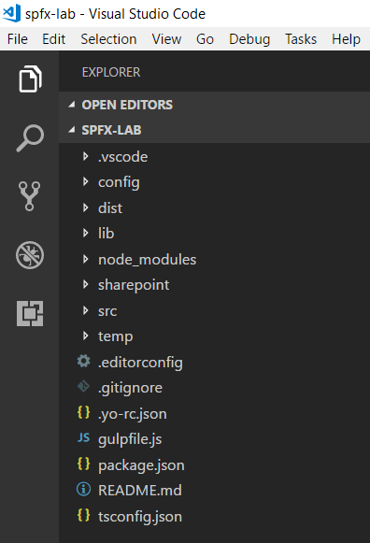
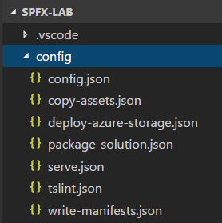
SPFx Project Configuration Files

Slide 9
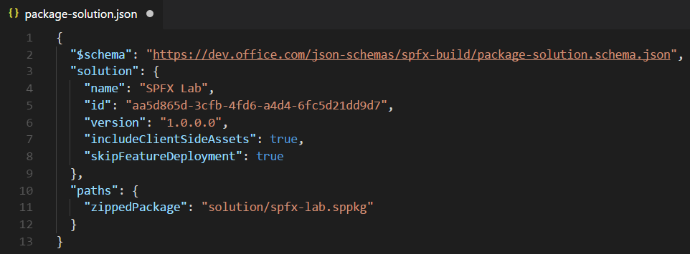
package-solution.json
package-solution.json
Contains top-level project properties (id, name, version)
includeClientSideAssets
skipFeatureDeployment
zippedPackage

Slide 10
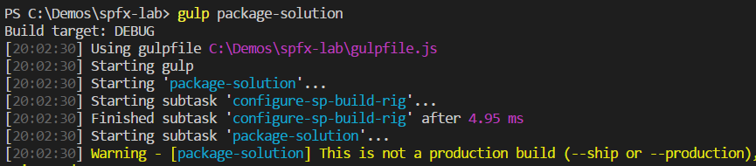
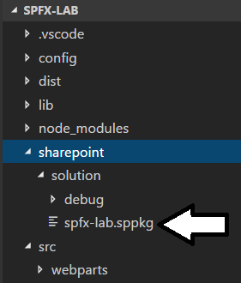
Building a SPFx Solution
Done by executing gulp package-solution
Can be done with or without --ship parameter
Generates zip archive with .sppkg extension

Slide 11
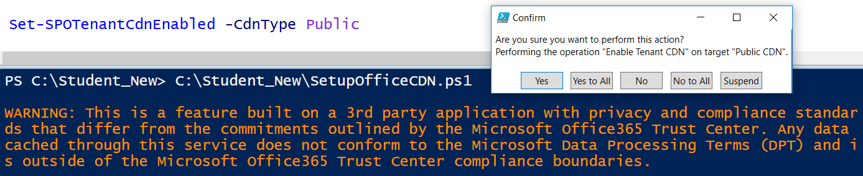
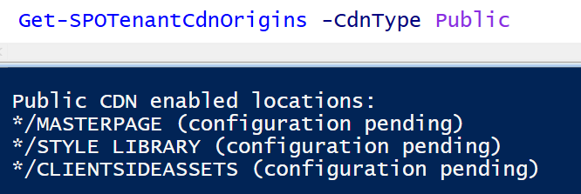
Enabling the Office 365 CDN
Office 365 provides CDN for SPFx solution deployment
Office 365 CDN must be enabled using PowerShell
Enabling CDN creates */CLIENTSIDEASSETS origin
CDN supports these file type extensions CSS, EOT, GIF, ICO, JPEG, JPG, JS, MAP, PNG, SVG, TTF, WOFF

Slide 12
includeClientSideAssets = True
If Office 365 CDN is enabled…
it will be used automatically with default settings.
If Office 365 CDN is not enabled…
assets will be served from app catalog site collection.

Slide 13
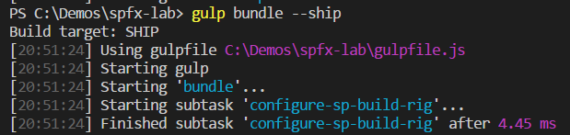
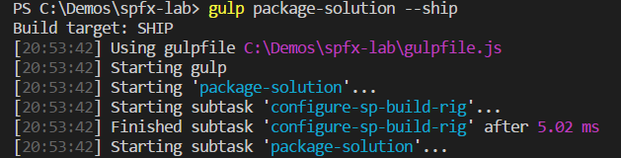
Packaging a SPFx Solution for Distribution
gulp bundle --ship
Uses dynamic URL for assets based on tenant CDN settings
gulp package-solution --ship
Uses dynamic URL for assets based on tenant CDN settings

Slide 14
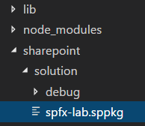
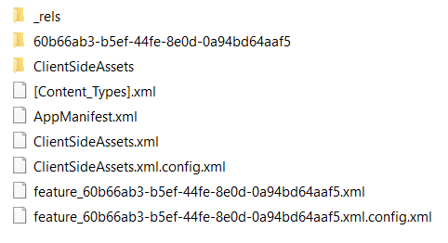
Inside a SPFx Solution Package
Your .js code is included in ClientSideAssets

Slide 15
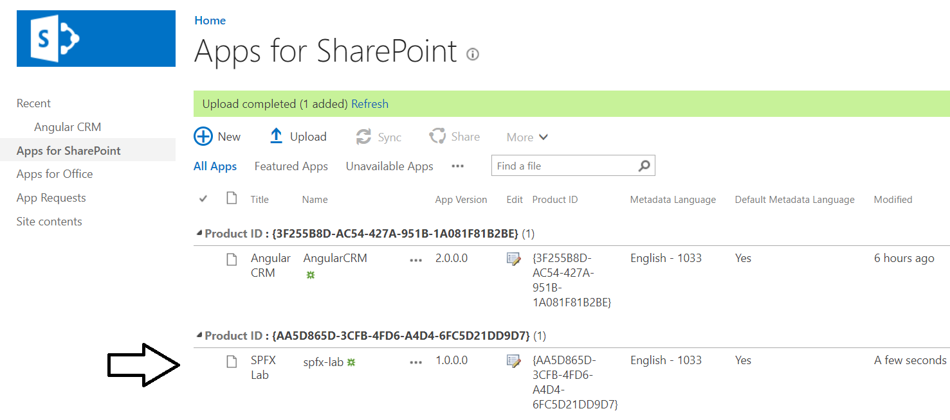
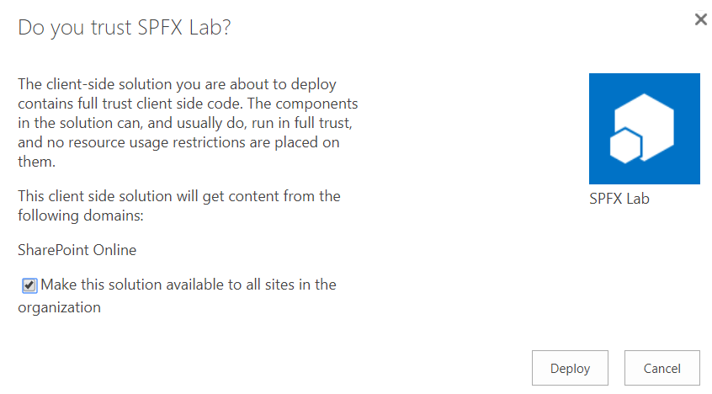
Deploying Solution to Office 365 Tenancy

Slide 16
Agenda
Understanding the SharePoint Online App Catalog
Publishing and Installing SharePoint Add-ins
Packaging SharePoint Framework Projects
Deploying Provider-hosted Add-ins

Slide 17
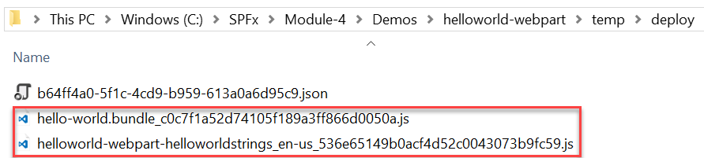
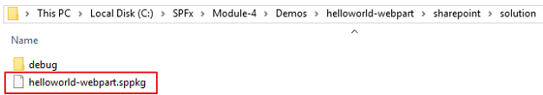
Package the web part
Use the bundle gulp task to build, localize, and bundle the project
Use the package-solution gulp task to package the project into a .sppkg file
The ship parameter build task creates a minified version of the bundle and copies all of the web part assets, including the web part bundle, into the temp\deploy folder. The .sppkg file is generated in the sharepoint\solution folder.
> gulp bundle --ship
> gulp package-solution --ship

Slide 18
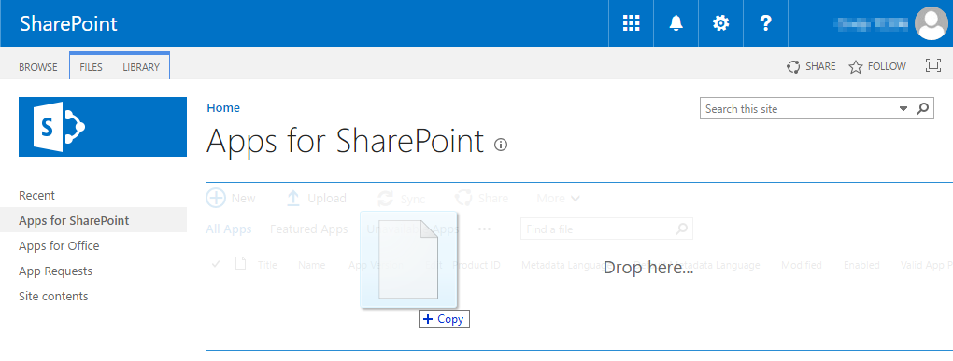
Deploy App to the SharePoint App Catalog
Go to your Office 365 App Catalog site
In the left sidebar, choose Apps for SharePoint
Upload the package (.sppkg file) for the web part

Slide 19
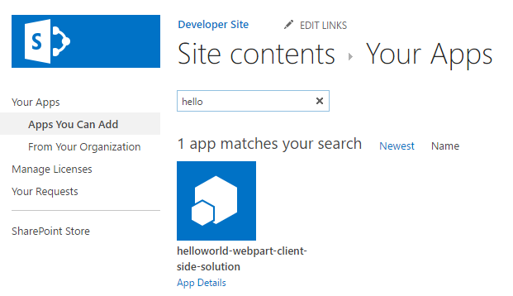
Install the App
Go to your Office 365 site
Add the App you just deployed to the SharePoint App Catalog

Slide 20
Deploy assets to a CDN and configure web part
At this point the web part will not run
You must first
deploy the web part assets to a CDN location
update the cdnBasePath in the write-manifests.json file
See the other sections in this module that describe how to
deploy to a SharePoint CDN and an Azure Storage CDN
update the cdnBasePath in the write-manifests.json file
{
"cdnBasePath": "<!-- PATH TO CDN -->"
}

Slide 21
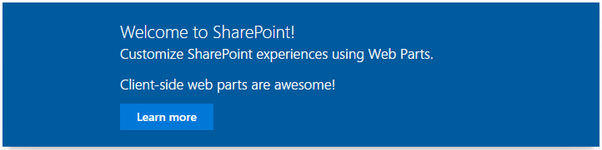
Add the web part to a SharePoint page
After the web part assets are deployed to a CDN location you can preview the web part
Create a page on your Office 365 site
Add the web part to the page

Slide 22
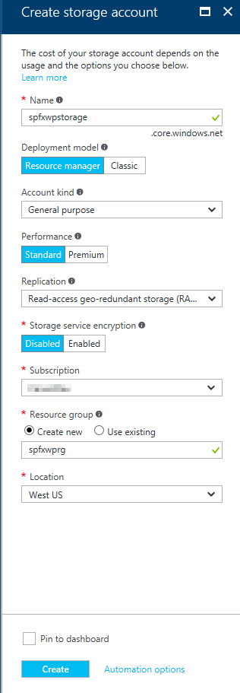
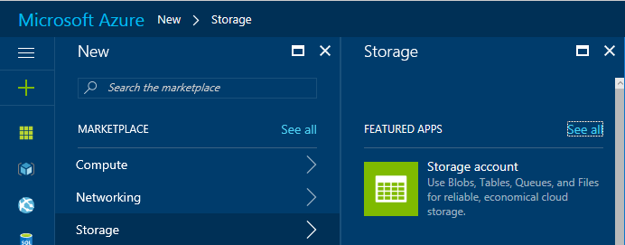
Create Azure Storage Account
Go to the Azure Management Portal
Create a new Storage Account

Slide 23
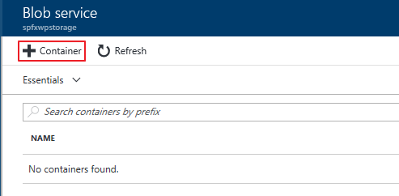
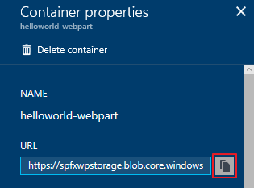
Create Blob Container in Storage Account
Create a Blob Container and copy the URL

Slide 24
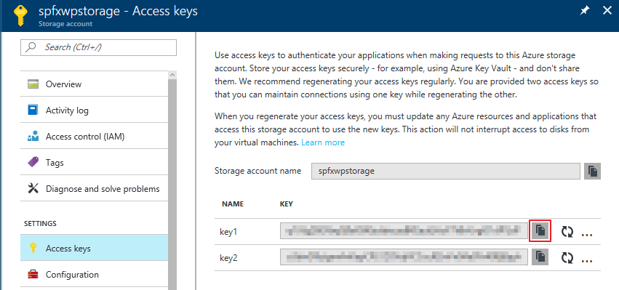
Obtain Storage Account Access Key
The Storage Account Access Key is used to automate deployments to the Azure Storage CDN, copy one of the keys

Slide 25
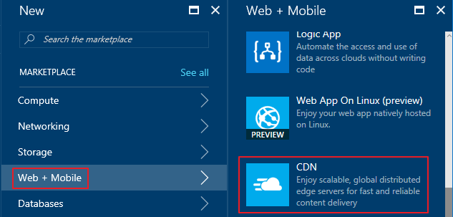
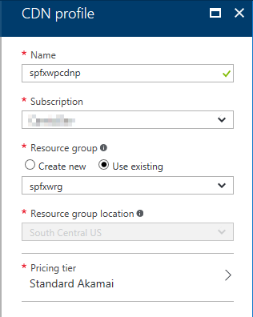
Create CDN Profile
In the Azure Management Portal, create a new CDN Profile

Slide 26
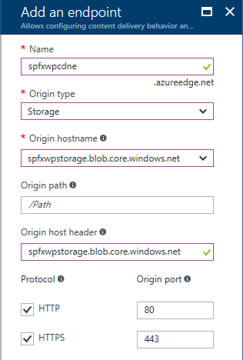
Create CDN Endpoint
In the CDN Profile, create a new CDN endpoint

Slide 27
Configure Webpart to Deploy Assets to CDN
Update the account, container, and accessKey in the deploy-azure-storage.json file
account – Storage account name
container – Name of the container you wish to use for the web part
accessKey – Storage Account Access Key
{
"workingDir": "./temp/deploy/",
"account": "spfxwpstorage",
"container": "helloworld-webpart",
"accessKey": "hL2503 … "
}

Slide 28
Configure the web part to use the CDN
Create CDN base path
https://<Storage Account Name>.blob.core.windows.net/<Container Name>
Update the cdnBasePath in the write-manifests.json file
{
"cdnBasePath": "https://spfxwpstorage.blob.core.windows.net/helloworld-webpart"
}

Slide 29
Deploy web part assets to the Azure Storage Account
Use the deploy-azure-storage gulp task to deploy the assets to the Azure Storage Account
> gulp deploy-azure-storage
deploy-azure-storage
> gulp deploy-azure-storage
Build target: DEBUG
[11:56:24] Using gulpfile C:\SPFx\helloworld-webpart\gulpfile.js
[11:56:24] Starting gulp
[11:56:24] Starting 'deploy-azure-storage'...
[11:56:24] Starting subtask 'deploy-azure-storage'...
[11:56:24] [deploy-azure-storage] Uploading files '**/*.*' from directory './temp/deploy/' to Azure
[11:56:25] [deploy-azure-storage] Created container: helloworld-webpart
[11:56:25] [deploy-azure-storage] Uploading [3] files...
[11:56:26] [deploy-azure-storage] Uploaded file: helloworld-webpart-helloworldstrings_en-us_536e65149b0acf4d52c0043073b9fc59.js
[11:56:26] [deploy-azure-storage] Uploaded file: hello-world.bundle_b8a80975dedeb31de300b580fab61182.js
[11:56:26] [deploy-azure-storage] Uploaded file: dd331d09-a9cd-448d-a687-7e43060191e2.json
[11:56:26] [deploy-azure-storage] Upload complete!
[11:56:26] [deploy-azure-storage] Access your files at: https://spfxwpstorage.blob.core.windows.net/helloworld-webpart
[11:56:26] Finished subtask 'deploy-azure-storage' after 1.92 s
[11:56:26] Finished 'deploy-azure-storage' after 1.93 s
[11:56:26] ==================[ Finished ]==================
[11:56:27] Project helloworld-webpart version: 0.0.1
[11:56:27] Build tools version: 2.4.0
[11:56:27] Node version: v6.10.0
[11:56:27] Total duration: 5.94 s

Slide 30
Install the App
Go to your Office 365 site
Add the App you just deployed to the SharePoint App Catalog

Slide 31
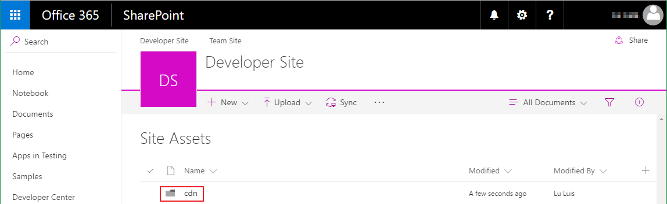
Create SharePoint CDN origin
Go to the Site Assets Document Library
Create a folder for the CDN origin

Slide 32
Enable the SharePoint CDN origin
Open the SharePoint Online Management Shell
Execute the following Powershell commands to enable the CDN, set the CDN origin, and return the CDN Origin ID
> $creds = Get-Credential
> Connect-SPOService -Url https://<TENANCY>-admin.sharepoint.com/ -Credential $creds
> Set-SPOTenant -PublicCdnEnabled $true
> Set-SPOTenant -PublicCdnAllowedFileTypes "CSS,EOT,GIF,ICO,JPEG,JPG,JS,MAP,PNG,SVG,TTF,WOFF,TXT"
> New-SPOPublicCdnOrigin -Url "https://<TENANCY>.sharepoint.com/sites/<SITE>/siteassets/cdn"
> Get-SPOPublicCdnOrigins
Notes:
Open the SharePoint Online Management Shell.
Connect to your Office 365 Developer Tenant within PowerShell session by executing the following commands:
$creds = Get-Credential
Connect-SPOService -Url https://<TENANCY>-admin.sharepoint.com/ -Credential $creds
Enable the Public CDN in the tenant by executing the following command:
Set-SPOTenant -PublicCdnEnabled $true
Configure the allowed file extensions by executing the following command:
Set-SPOTenant -PublicCdnAllowedFileTypes "CSS,EOT,GIF,ICO,JPEG,JPG,JS,MAP,PNG,SVG,TTF,WOFF,TXT“
Add the CDN Origin by executing the following command:
New-SPOPublicCdnOrigin -Url "https://<TENANCY>.sharepoint.com/sites/dev/siteassets/cdn“
Get the CDN Origin Id by executing the following command:
Get-SPOPublicCdnOrigins

Slide 33
Configure the web part to use the CDN
Create CDN base path
Update the cdnBasePath in the write-manifests.json file
https://publiccdn.sharepointonline.com/<TENANCY>.sharepoint.com/<your-CDN-origin-Id>
{
"cdnBasePath": "https://publiccdn.sharepointonline.com/<TENANCY>.sharepoint.com/<your-CDN-origin-Id>"
}
Notes:
Your CDN base path should be: https://publiccdn.sharepointonline.com/<TENANCY>.sharepoint.com/<your-CDN-origin-Id>. Replace the <TENANCY> placeholder with the name of your Office 365 tenant, and the <your-CDN-origin-Id> placeholder with the CDN Origin Id you created in the previous steps.

Slide 34
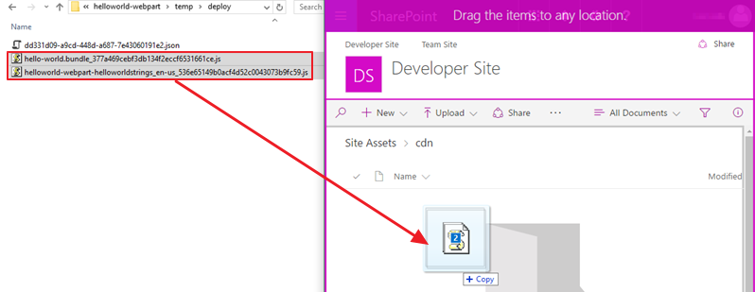
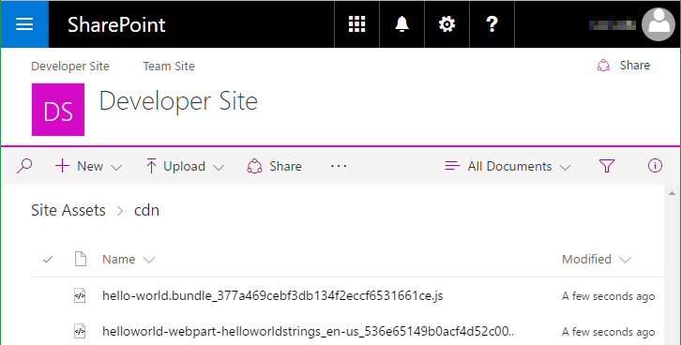
Deploy web part assets to the SharePoint CDN
Go to the Site Assets Document Library
Upload the assets for your web part to the CDN enabled folder

Slide 35
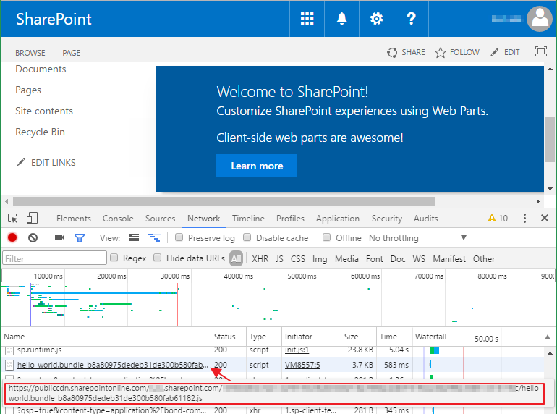
Add the web part to a SharePoint page
After the web part assets are deployed to a CDN location you can preview the web part
Create page in your SPO site and add the web part to the page
In the developer console verify the assets are served from the CDN

Slide 36
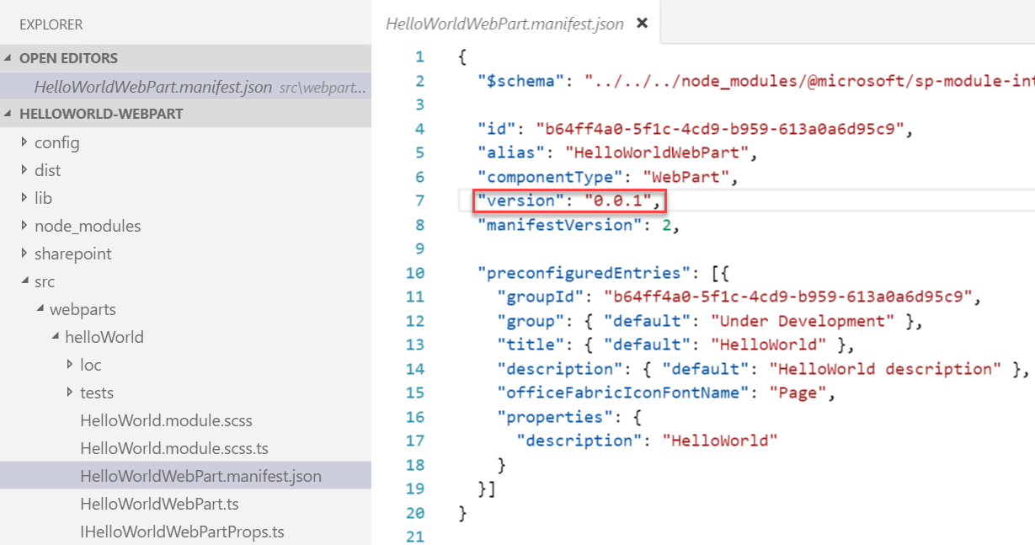
Update Webparts and Increment Version
Update the code or configuration for your web part
Increment the version in the <web part name>.manifest.json file
This sets the version for the web part
Multiple web parts in the same solution may be versioned independently

Slide 37
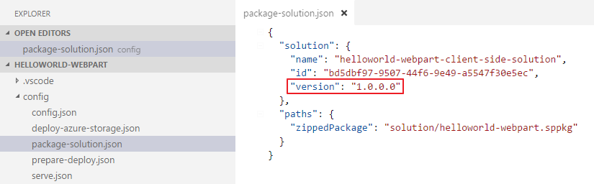
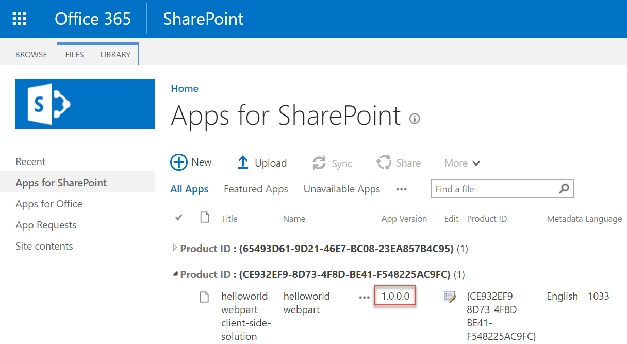
Update Version in package-solution.json
This sets the version for the .sppkg Add-in
This version is displayed in the app catalog

Slide 38
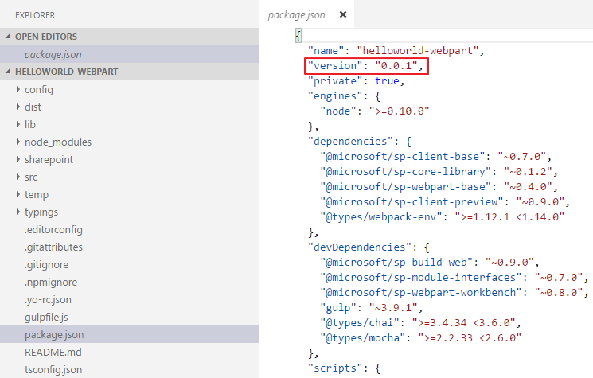
Update the version in the package.json file
Change the version every time the package changes
Notes:
The most important things in your package.json are the name and version fields. Those are actually required, and your package won't install without them. The name and version together form an identifier that is assumed to be completely unique. Changes to the package should come along with changes to the version.
Version must be parseable by node-semver, which is bundled with npm as a dependency. (npm install semver to use it yourself.)
More on version numbers and ranges at semver.

